Slide 1
Improving object detection for Infrared images using YOLO
Emil Vardar, Fanxuan Liu, Qian Zhou, Xiaolong Sun, Yutong Jiang
Project owner: Meng Zhang

Slide 2
Overview
Introduction/motivation
Problem statement
Approach and major task
Results
Conclusion
Lessons learnt
Contribution

Slide 3
Introduction/Motivation
Motivation:
Object detection models have achieved promising results in various tasks
A challenging task in infrared images, as most models only focus on visible images
Target:
Design and build a YOLO-based network to detect objects for infrared images
Improve the network to increase its accuracy

Slide 4
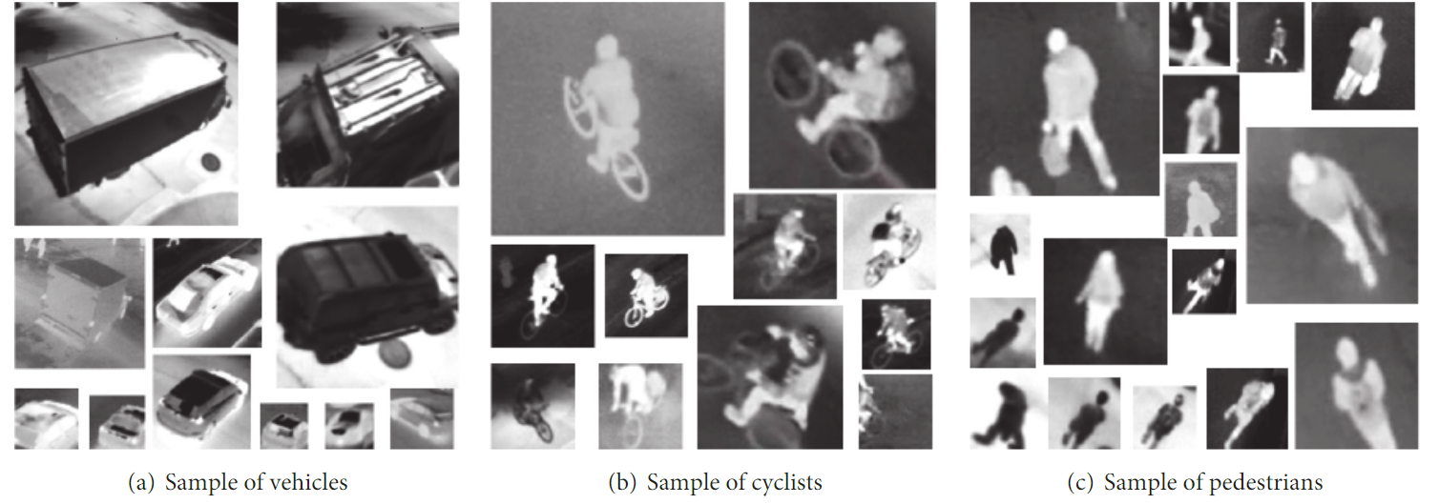
Object detection for Infrared (IR) Image
IR images are images captured with infrared light
Not distinguished in the shape and boundary
The resolution is lower compared to RGB images
Contain much more noise (e.g.Gaussian noise)
Sensitive to temperature changes

Slide 5
Approach
Add P2 feature map layer
Dilation and sub-pixel conv
Combination of P2 and dilation
Attention
Image Denoise
Image Enhancement
BotNet
MAE with Yolo

Slide 6
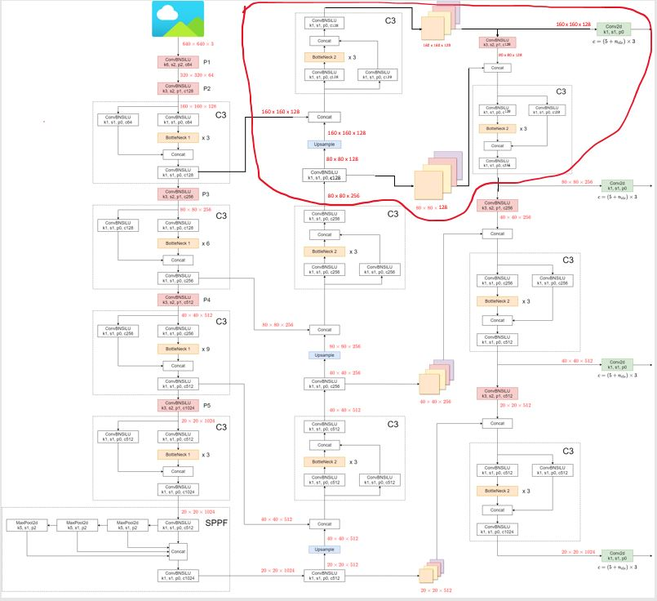
Adding P2 Layer
[1]
Basic YOLO
mAP: 0.426
YOLO with P2 layer
mAP: 0.446
Notes:
→ I know that you cannot see anything from this image. But it doesn’t matter the important part is the red circled area. This is the part we have added to YOLO.
→ Let us look a little closer to this red circled area (go to next slide).
[1] https://github.com/ultralytics/yolov5/issues/6998 → image credit (put it in the references)

Slide 7
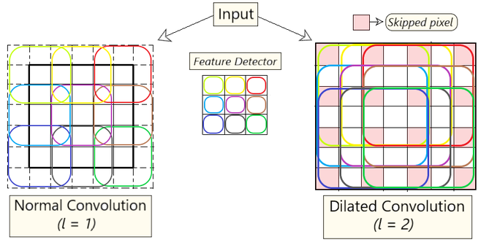
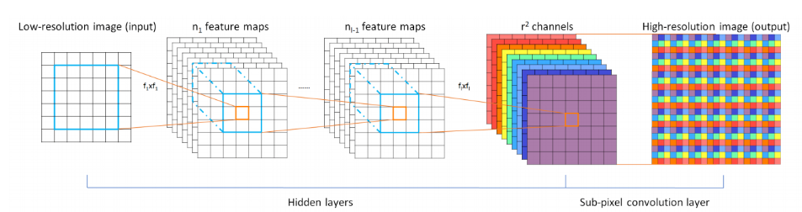
Dilation and sub-pixel conv
Dilation convolution:
Sub-pixel convolution:
mAP:0.426
Notes:
Dilation convolution enlarges the receptive field and extracts the coarse-grained information without additional computational complexity. expand the kernel (input) by inserting holes between its consecutive elements. In simpler terms, it is the same as convolution but it involves pixel skipping, so as to cover a larger area of the input.
Sub-pixel convolution fuses multi-channel features to extract the sub-pixel information and reposition the features in pixel level. splits each original channel into multiple channels according to pixels, and then combines them into new channels. This operation expands the receptive field while reducing the loss of information without increasing the complexity of the network.

Slide 8
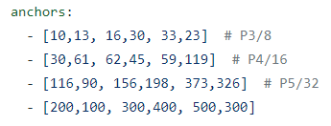
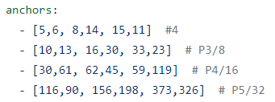
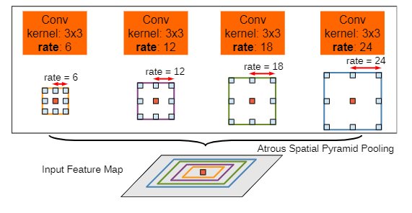
Combination of P2 and dilation
Basic YOLO | Improved YOLO
mAP: 0.426 | mAP: 0.473
P2: Parameter change especially for small object
ASPP:
Obtain a larger receptive field without losing too much resolution!

Slide 9
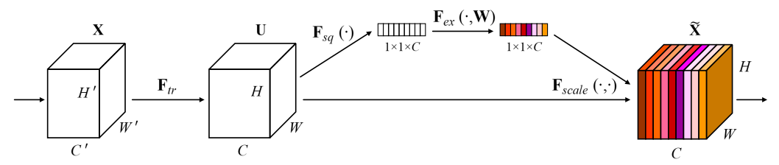
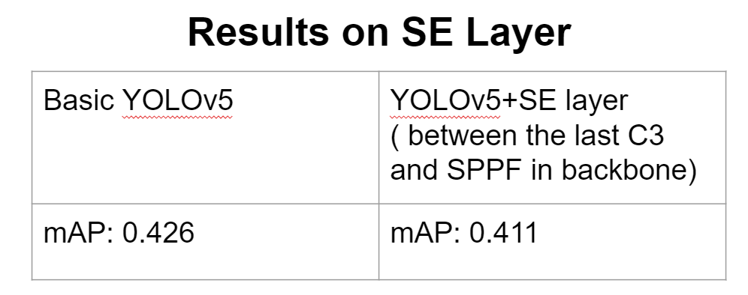
Attention
Squeeze-and-Excitation Networks

Slide 10
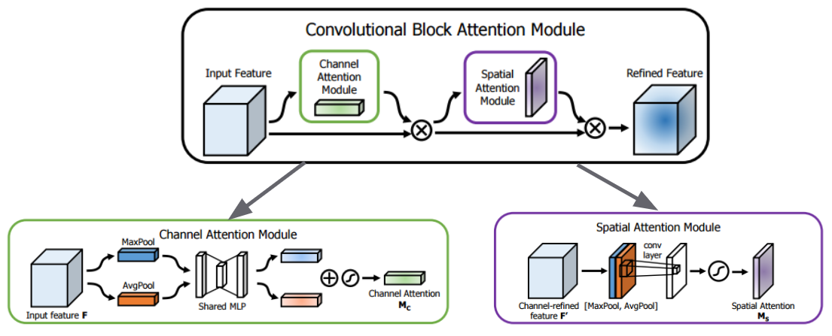
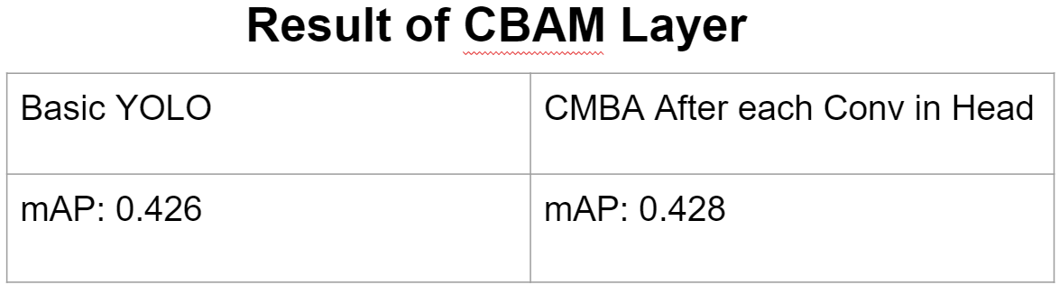
Attention
CBAM: Convolutional Block Attention Module

Slide 11
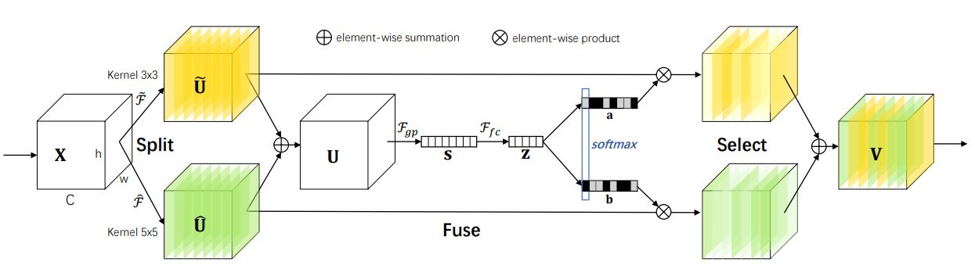
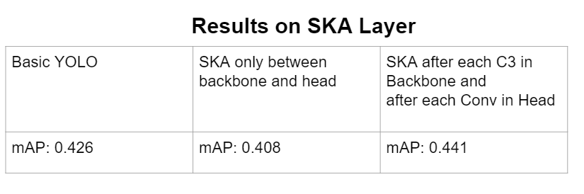
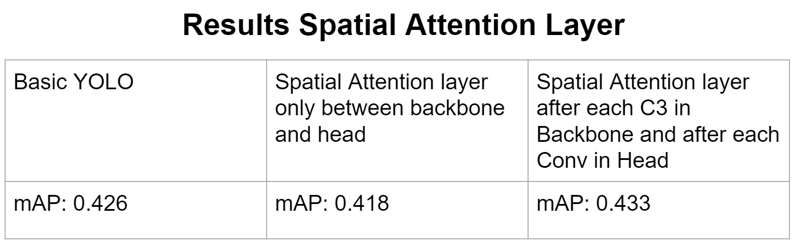
Attention
Selective Kernel Attention (SKA) Layer & Spatial Attention (SA) Layer

Slide 12
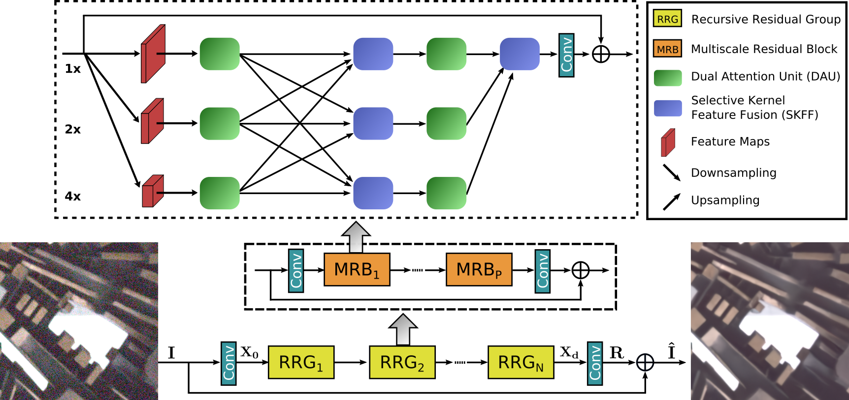
Image denoising and enhancement
MIRNet:
Zamir, S.W. et al. (2020) Learning enriched features for Real image restoration and enhancement, arXiv.org. Available at: https://arxiv.org/abs/2003.06792 (Accessed: November 24, 2022).
Notes:
In this part we use a MIRNet to learn enriched feature representations for image restoration and enhancement
The network structure is shown here.

Slide 13
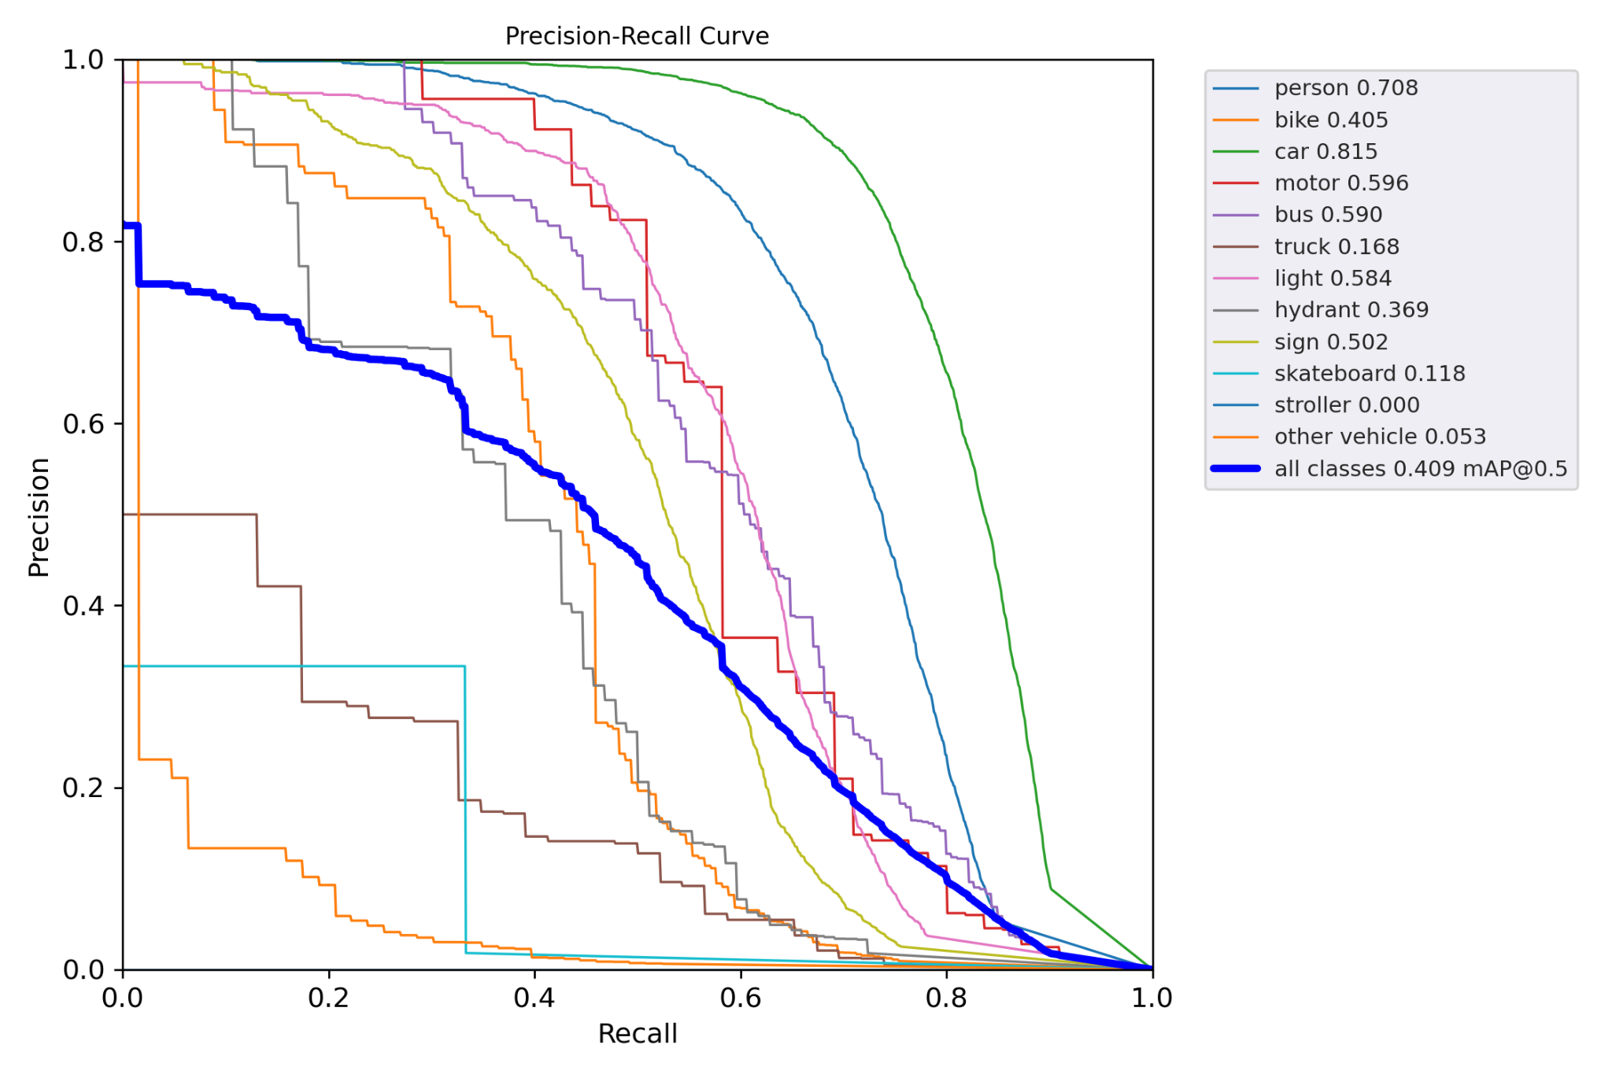
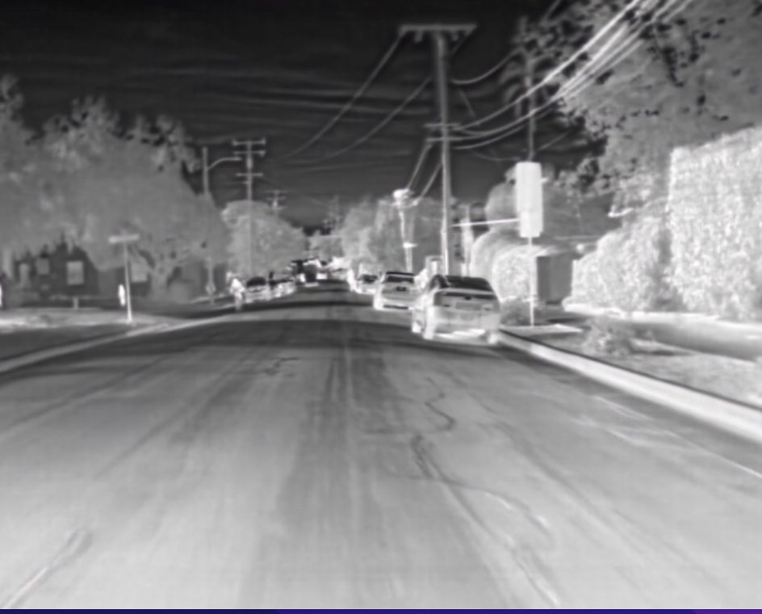
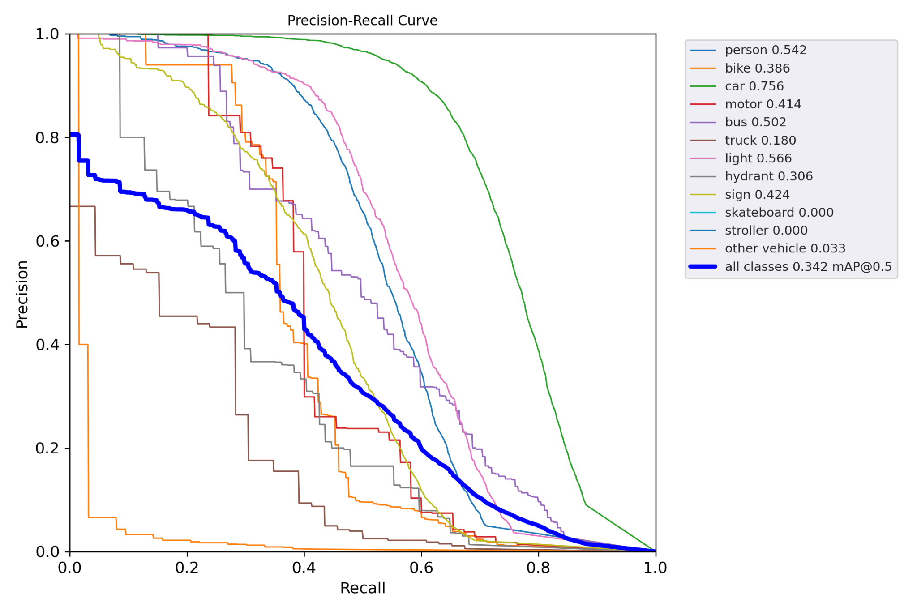
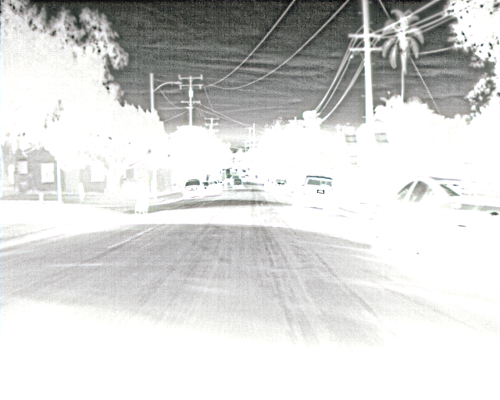
Result of image enhancement
Denoising:
Model | Image denoising
mAP | 0.409
Enhancement:
Model | Image enhancement
mAP | 0.342

Slide 14
Experiments after mid-term presentation

Slide 15
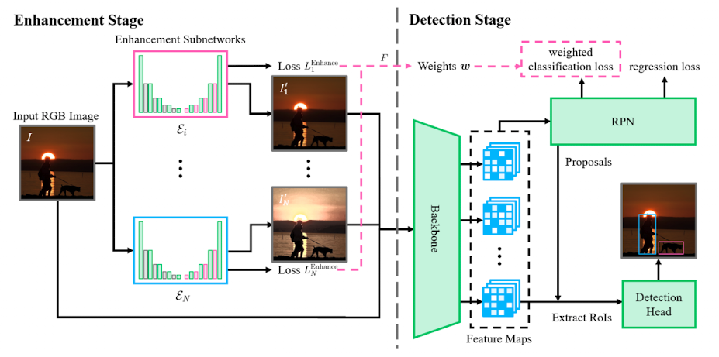
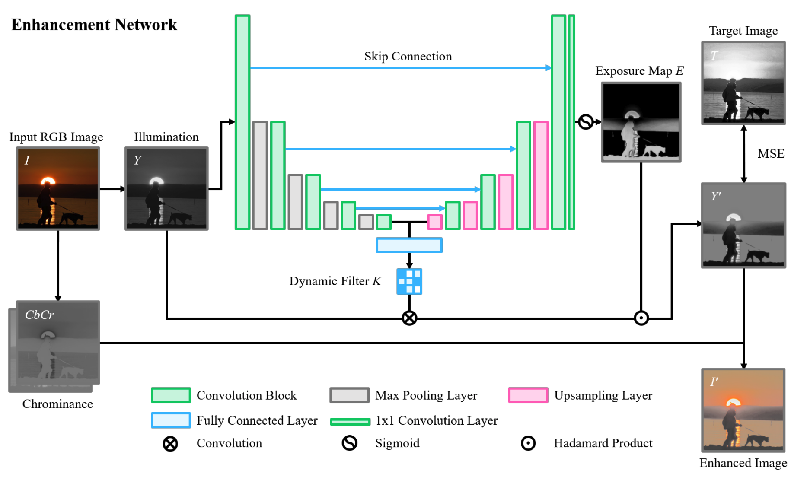
Enhancement
Dynamic Filter: simulate specific enhancement method
Adaptive Exposure Module: activate areas in the image to improve detect performance
Guo H, Lu T, Wu Y. Dynamic Low-Light Image Enhancement for Object Detection via End-to-End Training[C]//2020 25th International Conference on Pattern Recognition (ICPR). IEEE, 2021: 5611-5618.

Slide 16
Enhancement
What has been implemented:
The architecture of enhancement stage
Problems during experiments:
To adapt this algorithm to Yolov5, the architecture of Yolov5 should be rewritten.

Slide 17
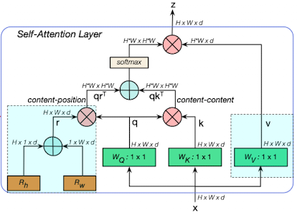
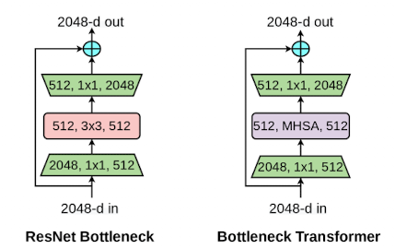
Bottleneck Transformer - good gains on small object
Bottleneck Transformer:
The difference is the replacement of the spatial 3*3 convolution layer with MHSA
MHSA:
4 heads is used, which is not shown in the figure for simplicity
Rh and Rw stands for relative position encoding for height and weight respectively
Srinivas, Aravind, et al. "Bottleneck transformers for visual recognition." Proceedings of the IEEE/CVF conference on computer vision and pattern recognition. 2021.

Slide 18
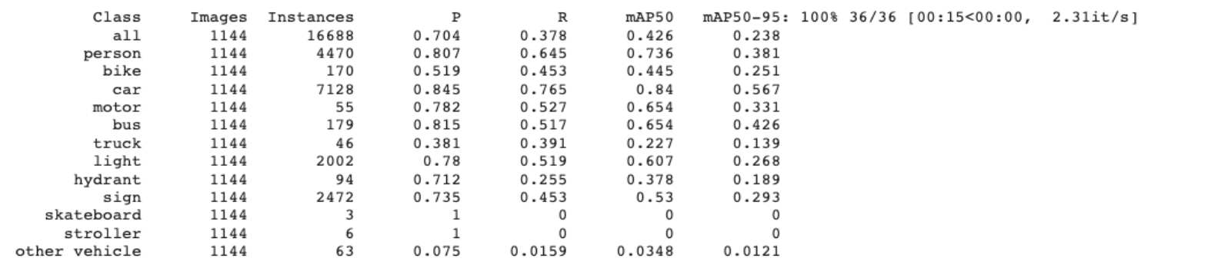
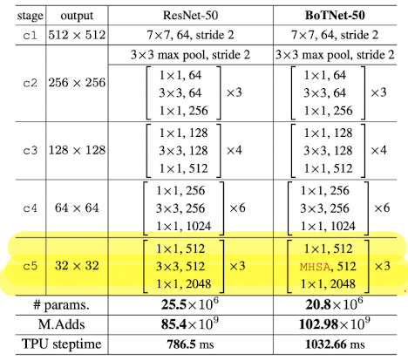
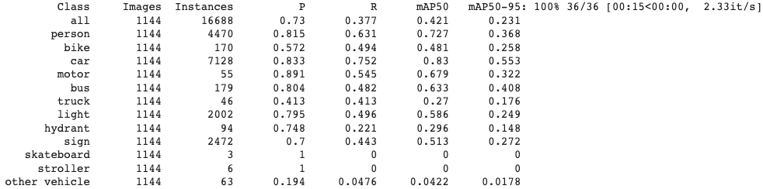
Bottleneck transformer
Results of basic Yolo
Results after applying bottleneck transformer
From the comparison, it is obvious to notice that there is an improvement in precision after applying bottleneck transformer.

Slide 19
Masked Autoencoder (MAE)
There are 2 training steps in MAE
Pretraining
Not the actual task (Reconstruction)
Self-supervised (I.e. no need for labeling)
Solves the appetite of data
Finetuning
The actual task
Supervised

Slide 20
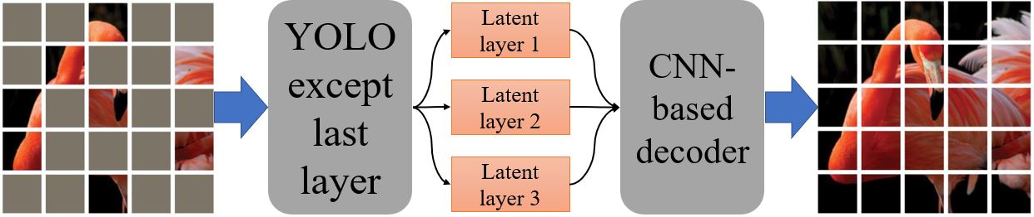
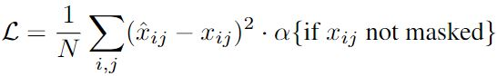
Pretraining
Randomly mask the input image
Feed the masked image through YOLO
Try to reconstruct the input image through a decoder
The loss is given by
α= 0 → masked loss
α= 1 → whole loss
This idea is adapted from He et al.’s ‘Masked Autoencoders Are Scalable Vision Learners’ 2022.

Slide 21
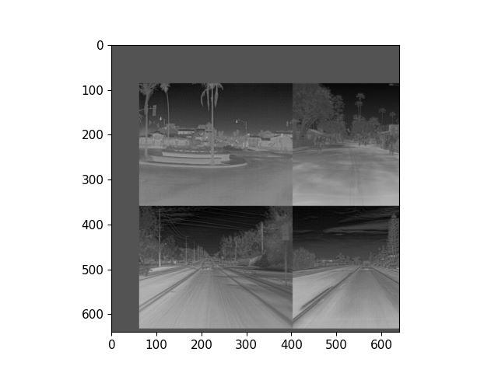
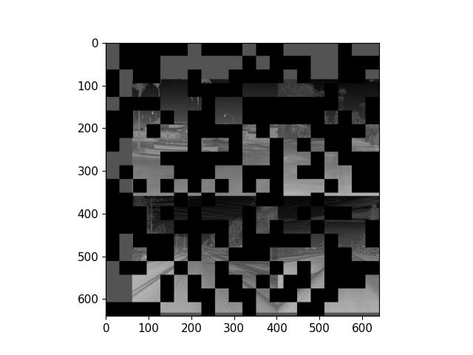
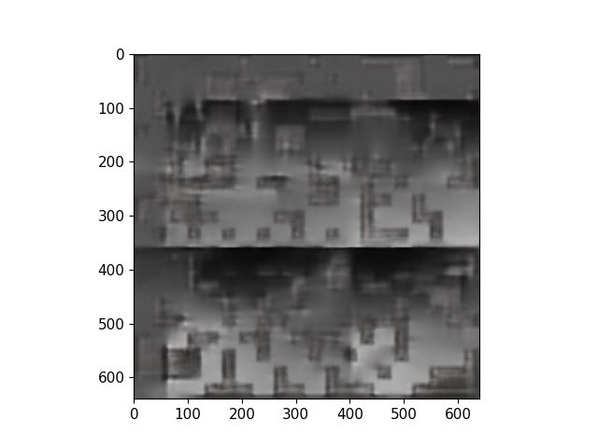
Reconstructed Images
Reconstructed images are not good but not bad either
Details about the dark and bright places are correctly reconstructed
Observe the pixelated reconstruction (In this experiment we used α= 0)

Slide 22
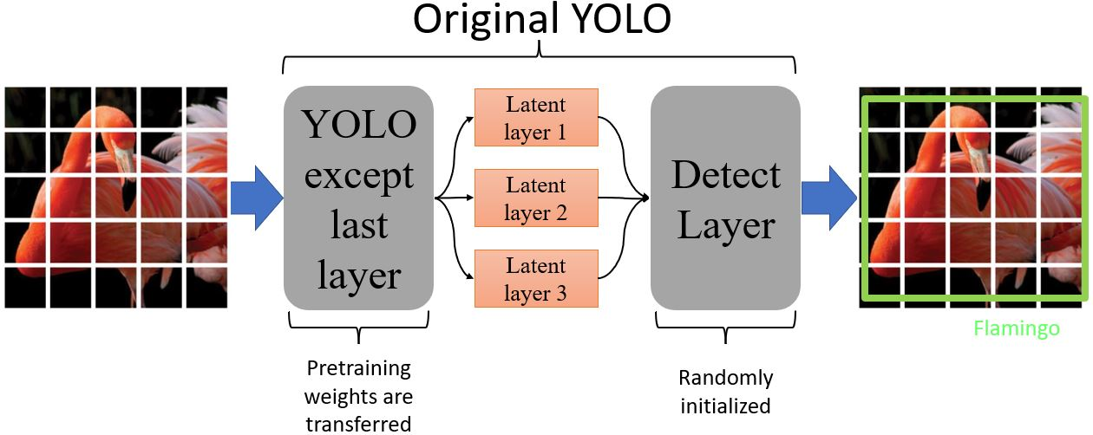
Finetuning
Finetuning in this case is exactly the same training as the original YOLO but with ‘pretrained’ weights from the pretraining.

Slide 23
Results for MAE
Case | Mean Average Precision (mAP)
Basic YOLO | 0.426
MAE YOLO Masking ratio=0.50 α=0 batch size =16 | 0.415

Slide 24
Why MAE approach does not work?
The pretraining does not add valuable information towards YOLO’s performance.
Don’t use pretraining.
Because IR images don’t contain intense information.
Smaller masking ratio should be tested (if time allows)
The Detect layer in YOLO having too much of an effect on the classification

Slide 25
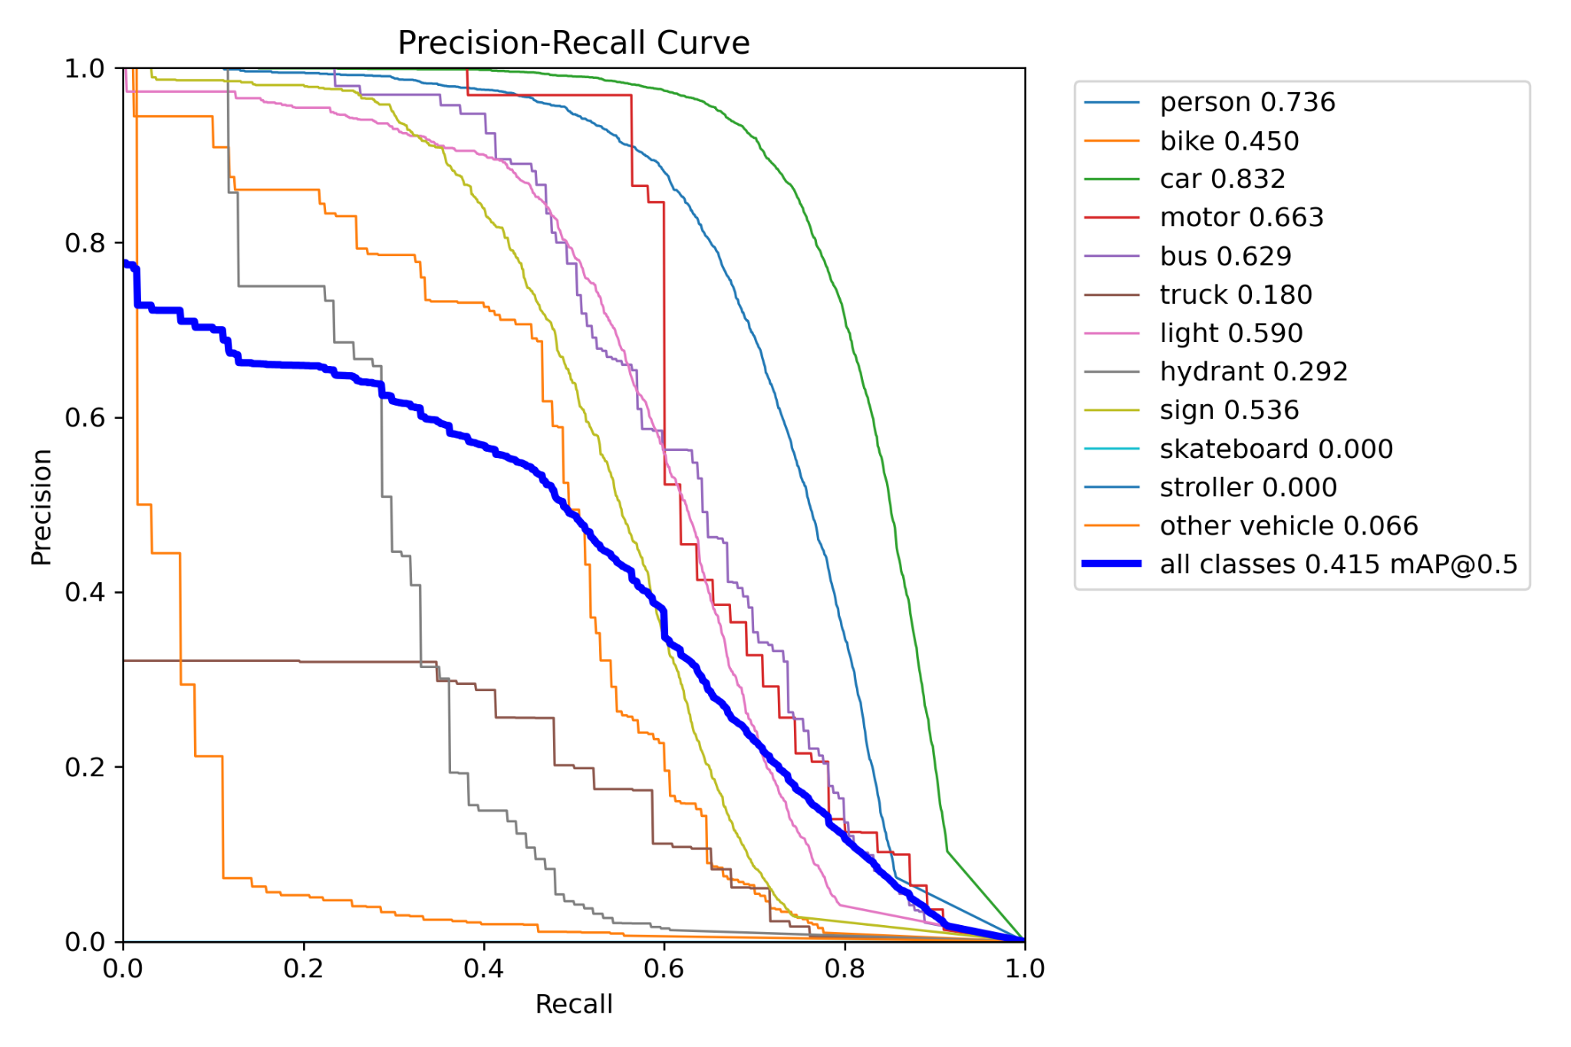
PR-curves
MAE YOLO (mr=0.50, α=0, bs=16)

Slide 26
Kaist dataset
Motivation:
The images in Flir dataset are quite good, and we can’t see a significant improvement.
Some proposals might work using a dataset with comparatively low quality.
Description:
Captures various regular traffic scenes at day and night time
Consists of 95k 640x480 color-thermal pairs taken from a vehicle
Four classes: person, people, cyclist, not sure

Slide 27
Conclusion
 | Basic YOLO | Adding P2 layer | Dilation and sub-pixel conv | SE Attention(1) | CBAM Attention(1) | SK Attention(1) | SK Attention(2)
Flir | 0.426 | 0.446 | 0.426 | 0.411 | 0.428 | 0.408 | 0.441
Kaist | 0.208 |  |  |  | 0.212
 | Spatial Attention(1) | Spatial Attention(2) | Image denoising | Image enhancement | MAE YOLO (mr=0.50, α=0, bs=16) | BotNet | P2 layer and dilation
Flir | 0.418 | 0.433 | 0.409 | 0.342 | 0.415 | 0.421 | 0.473
Kaist |  |  |  |  |  | 0.206
(1): attention layer only between backbone and head
(2): attention layer after each C3 in Backbone and after each Conv in Head

Slide 28
Lessons learnt
Proposals working:
P2 layer
Combination of P2 layer and dilation conv
CBAM Attention with attention layer only between backbone and head
SK Attention with attention layer after each C3 in Backbone and after each Conv in Head
Spatial Attention with attention layer after each C3 in Backbone and after each Conv in Head
How we adjusted:
Improved the structure in different ways e.g. adding one layer or multiple layers
Tried different parameters
Combined two proposals
Used different datasets
Wish to have done differently:
Start to deal with Kaist dataset earlier
Try to find out a balance between accuracy and speed when experimenting

Slide 29
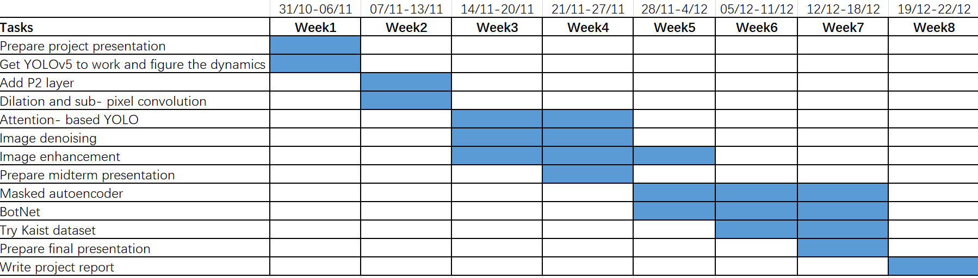
Timeline

Slide 30
Contribution
 | Emil | Yutong | Qian | Xiaolong | Fanxuan
Flir Dataset | √ | √
Kaist Dataset |  | √ |  | √
P2 Layer | √ |  | √
Subpixel and Dilation |  |  | √ | √ | √
Attention | √ |  | √ |  | √
Image Denoise |  | √ |  | √
Image Enhancement |  | √ |  | √ | √
MAE YOLO | √ |  | √ |  | √
MHSA |  | √ |  | √

